Slide 1
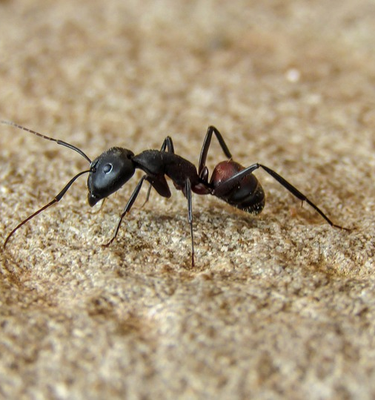

Back to home in desert
navigation by landmarks or memory
reproduce testing data by simulation
based on thesis by R. Wehner 1998

